Slide 1
Fresh Grads – Group Project
Online Admission System

Slide 2
Project Group Size
6

Slide 3
Development of Online Admission Management System (OAM).
-Online Admission Management (OAM) is an application, which develops a user interface for colleges or universities which offer admission to various courses.
-It provides provision for students to apply for a course and get admission.
-Administrator can add/modify the course, approve / reject the students’ applications, view applications, view course, view the details of courses taken by students and search by course.

Slide 4
Road Map-
Application will be developed in following Sprints –
Core Java +JPA with Hibernate +Mysql/PostGre
Spring Boot + Rest Controller + JPA with Hibernate
Angular/ReactJS for UI design (Front End) + Integration with previous Sprint2

Slide 5
Development of Online Admission Management System (OAM).
The system will be developed in 3 different sprints using java and java base technology using either angular or reactjs as front end framework.
In sprint1 for user interaction, system will use console application (Java).
In sprint2 ,application will be created using spring restful web service and will be executed by Postman/Swagger
In sprint3 for user interaction, system will use angular or react js pages.

Slide 6
Development of Online Admission Management System (OAM).
User - Administrator
-Admin will login to the online admission system
-Admin can see all the detail in brief.
-Admin can view user detail and update user detail.
-Admin can view all application. Admin can view application and documents on the basis of status(pending application, approve an application and reject application).
-Admin also can approve pending application.
-Admin can search application on the basis of user name, email id, and contact number.
-Admin can manage courses(add and update).
-Admin can view payment details.

Slide 7
Development of Online Admission Management System (OAM).
User- Student
-Student can see the status of his application.
-Student can fill the admission application form .
-Student can check his / her application form is selected or rejected(which is done by admin).
-Student can upload their own document if his/ her form is accepted by admin.
- Student can not upload their own document if his/ her form is rejected by admin.
- Student user can also update his/ her profile, change the password.
- Student can make payment for the course.

Slide 8
Plan
Design
Generate the skeleton as per class design provided
TDD approach
Identify test cases for each module
Write Failing Test cases
Convert the Test Cases in GREEN
Implement the case study in incremental manner

Slide 9
Modules
Login Management Module
Application Management Module
Cource
Management Module
College Management Module
Payment
Management Module
University Mnagement modul

Slide 10
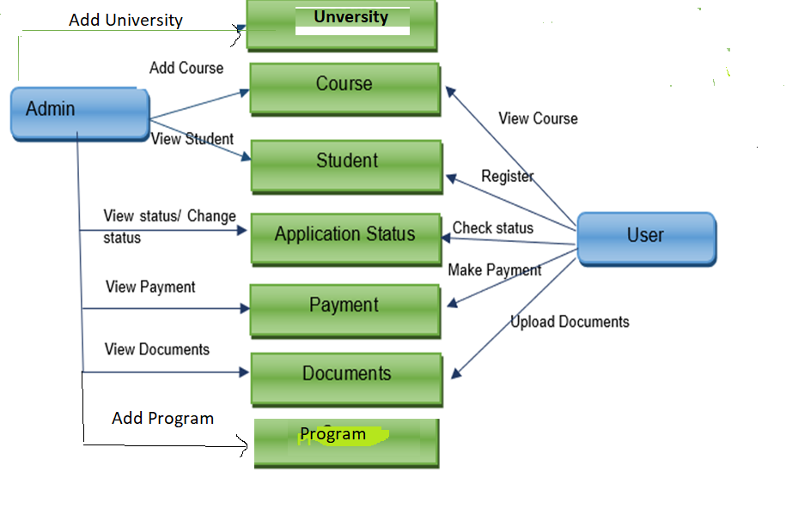
Use Case Diagram

Slide 11
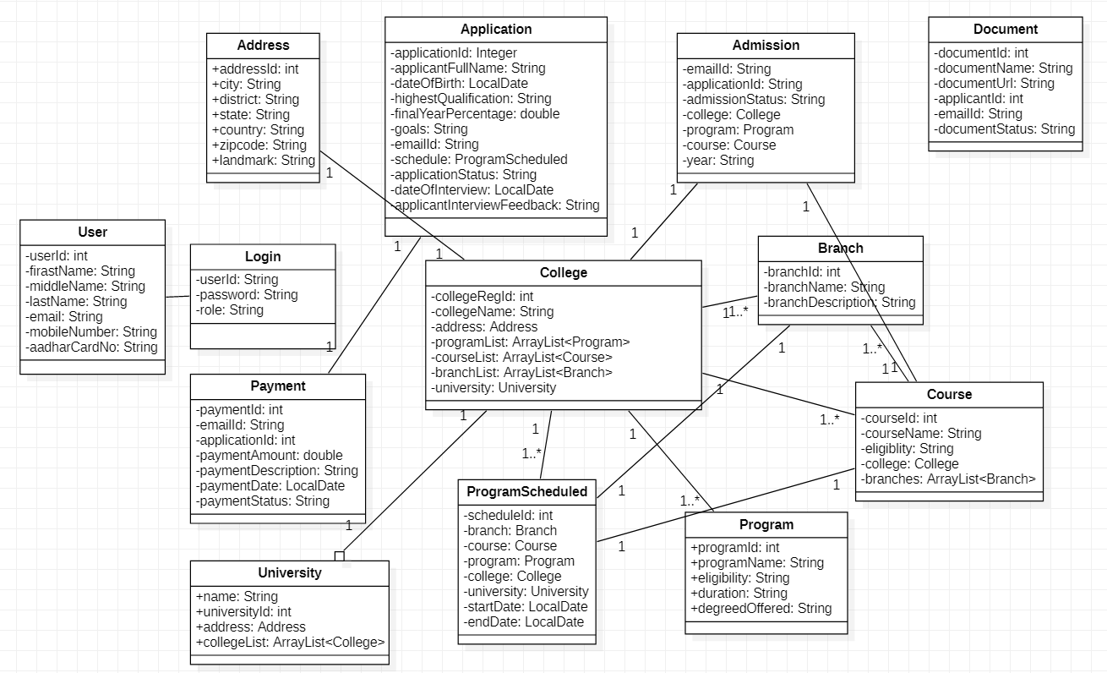
Class Design
POJO Classes:

Slide 12
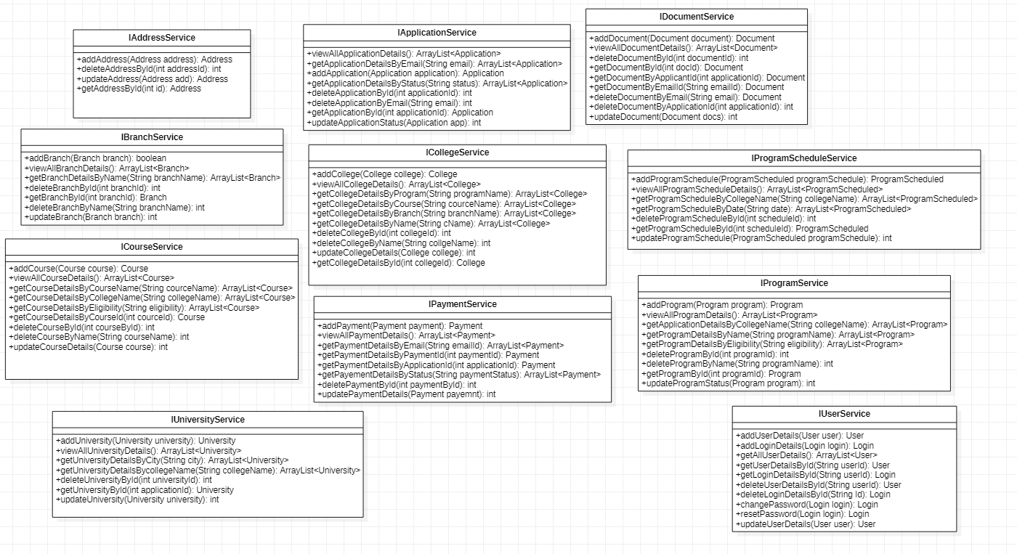
Class Design
Service Interface:

Slide 13
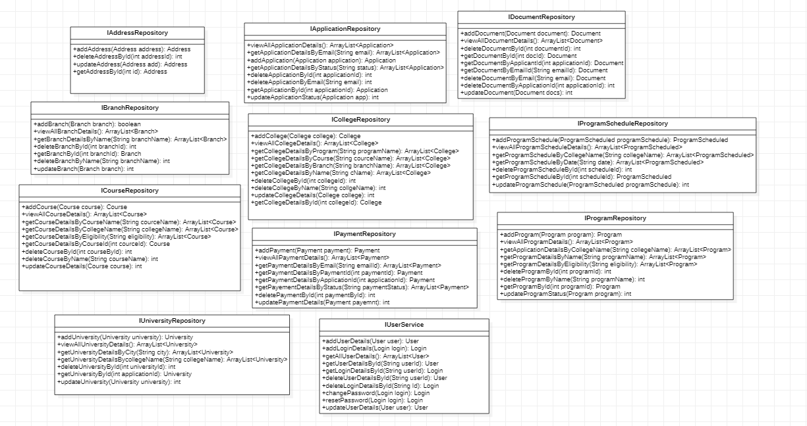
Class Design
Repository:

Slide 14




Questions

